Slide 1
FaceNet: A Unified Embedding for Face Recognition and Clustering
(Florian Schroff, Dmitry Kalenichenko, James Philbin, 2015)

Slide 2
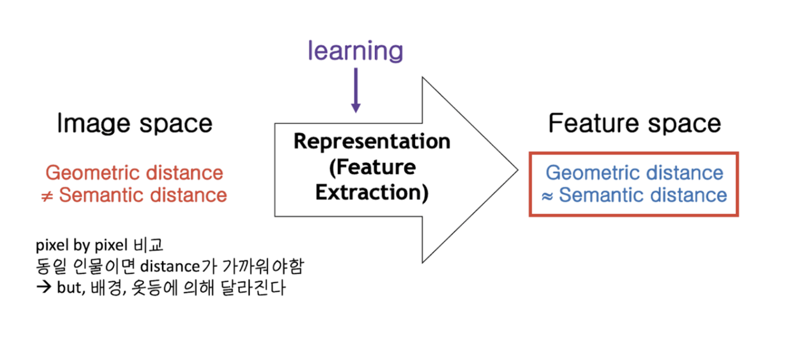
Background - Metric Learning

Slide 3
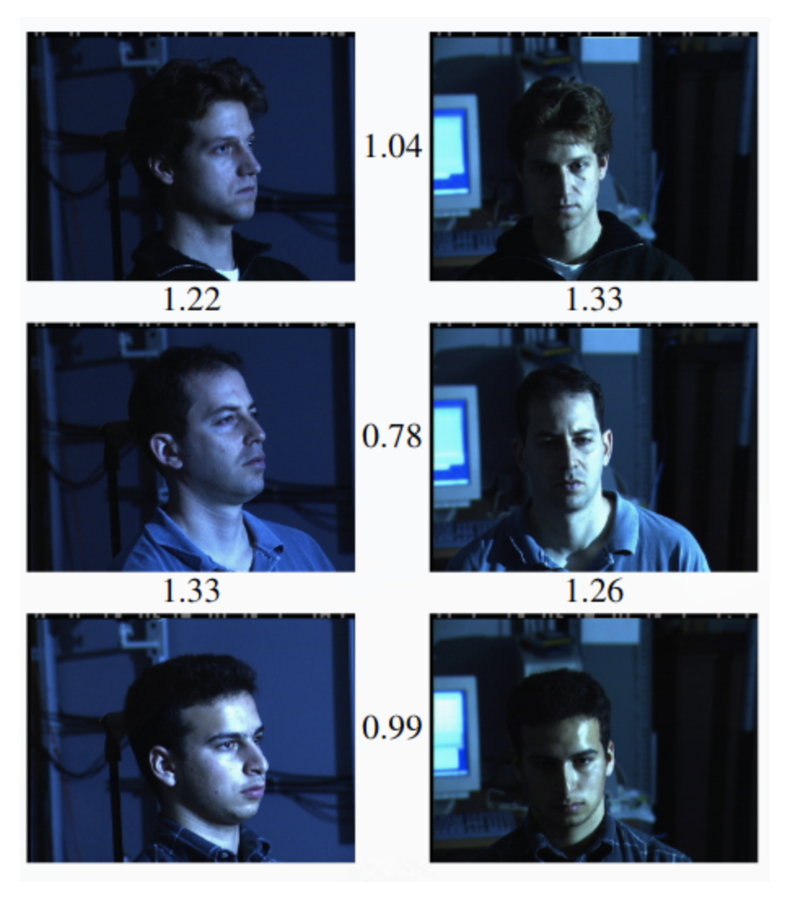
Abstract & Introduction

Slide 4
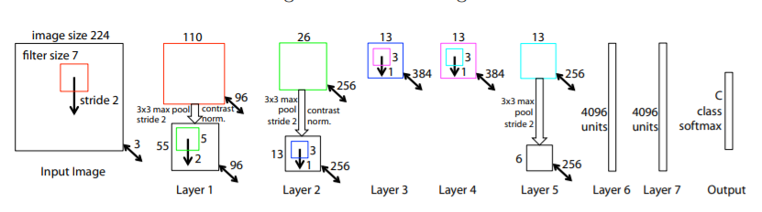
Related Work - based model
- Visualizing and understandingconvolutional networks
Visualizing and Understanding Convolutional Networks, Matthew D. Zeiler and Rob Fergus Dept. of Computer Science, New York University, USA, 2014

Slide 5
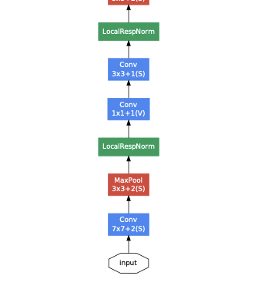
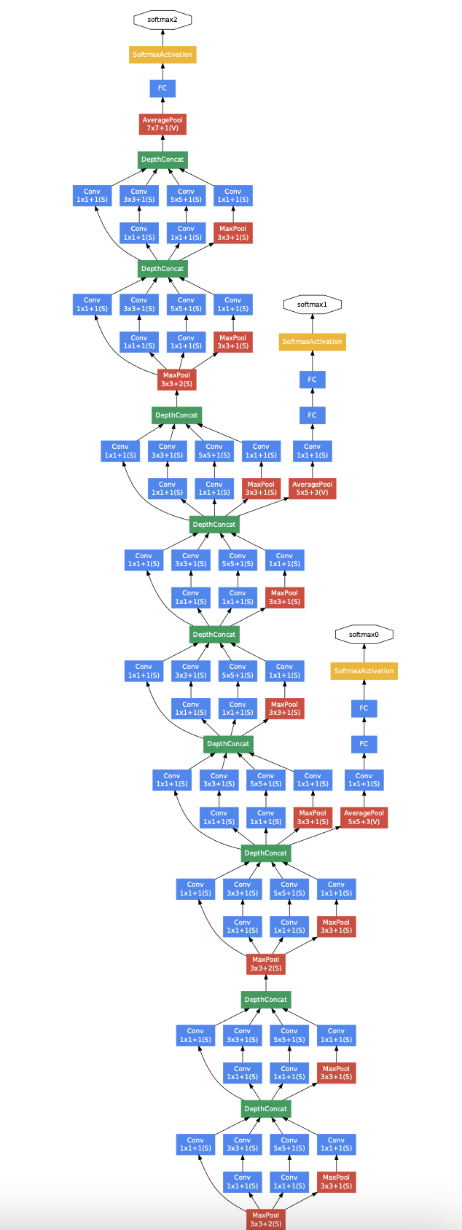
Related Work - based model - Inception model
- Going deeper with convolutions
Going deeper with convolutions, Szegedy, Dept of Computer Vision and Pattern Recognition, Cornell University, 2014

Slide 6
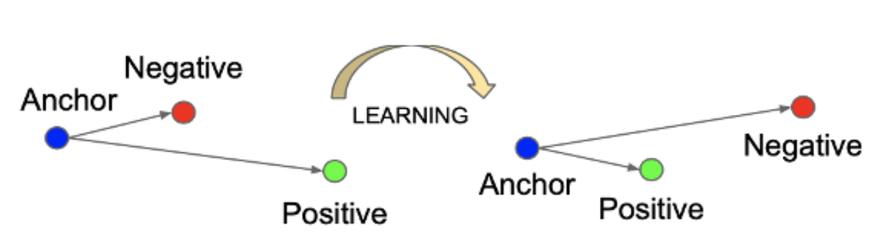
Method - Triplet Loss

Slide 7
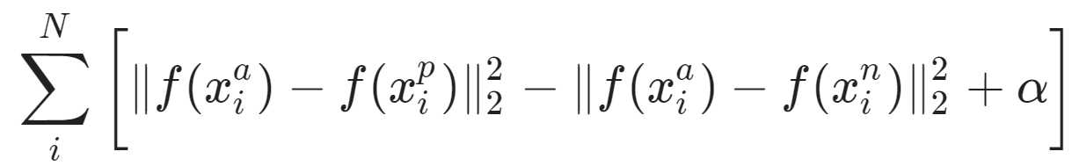
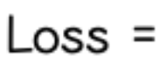
Method - Triplet Loss

Slide 8
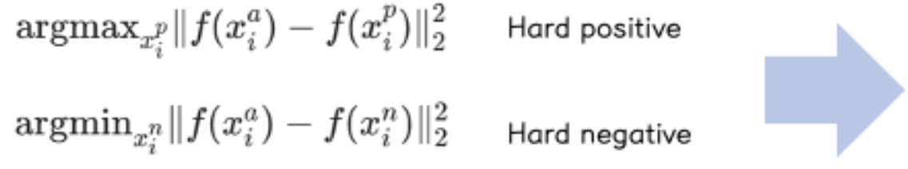
Method - Triplet Selection
계산량
오버피팅 문제

Slide 9
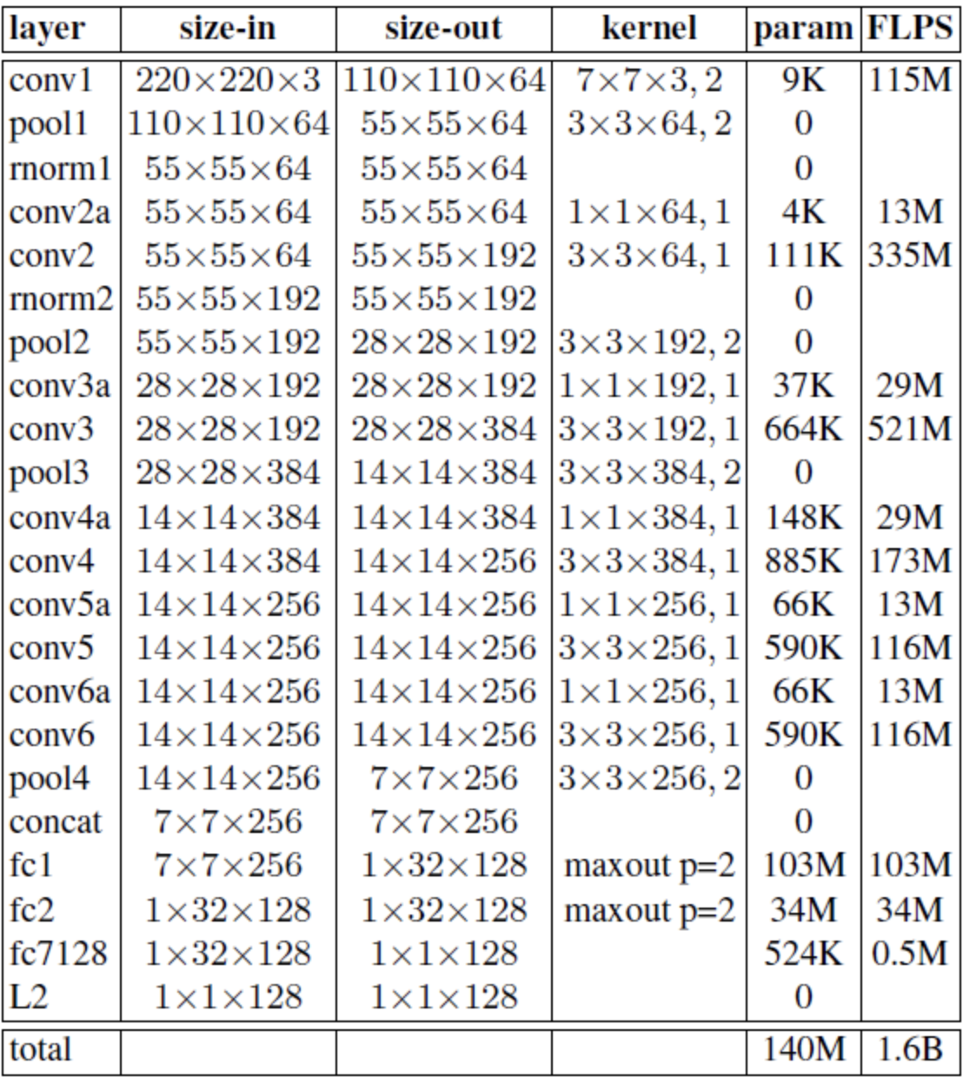
Method - Deep Convolutional Networks - NN1

Slide 10
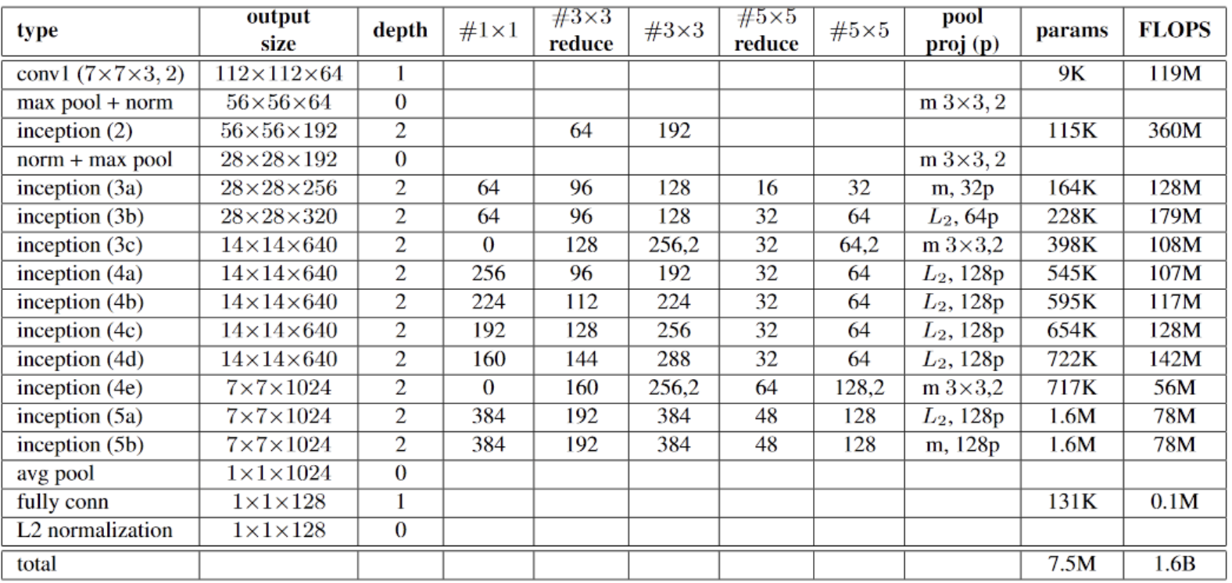
Method - Deep Convolutional Networks - NN2

Slide 11
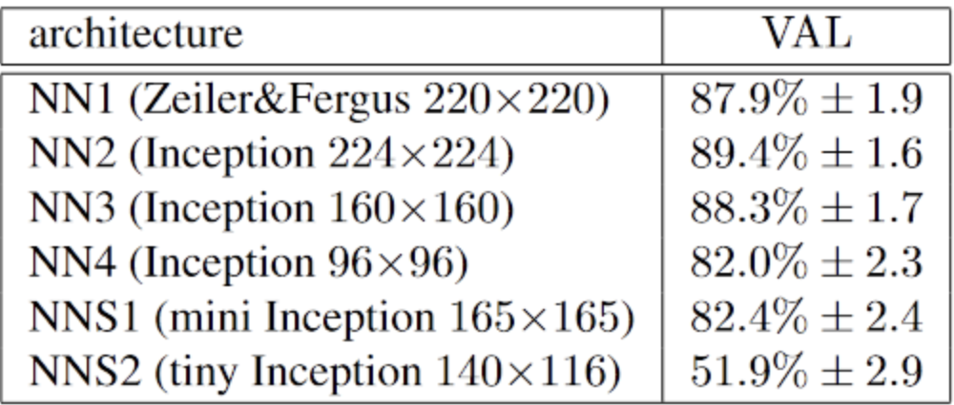
Method - Deep Convolutional Networks

Slide 12
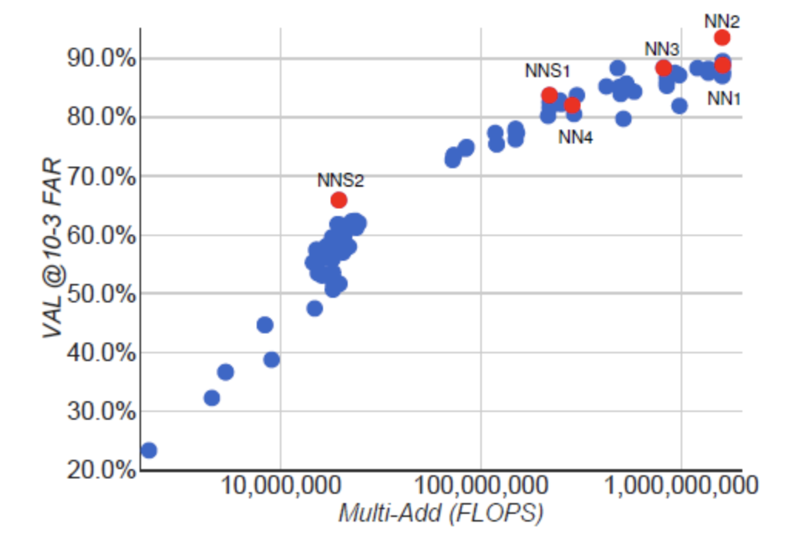
Method - Deep Convolutional Networks

Slide 13
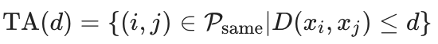
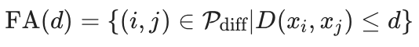
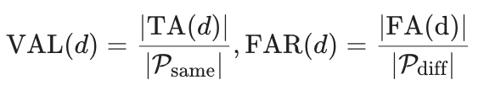
Datasets and Evaluation

Slide 14
Datasets and Evaluation
Hold-out Data Set
Personal Photos
Academic Datasets

Slide 15
Experiments - Computation Accuracy Trade-off
정확도 , FLOPS : Trade-off 관계
정확도 FLOPS
FLOPS 정확도

Slide 16
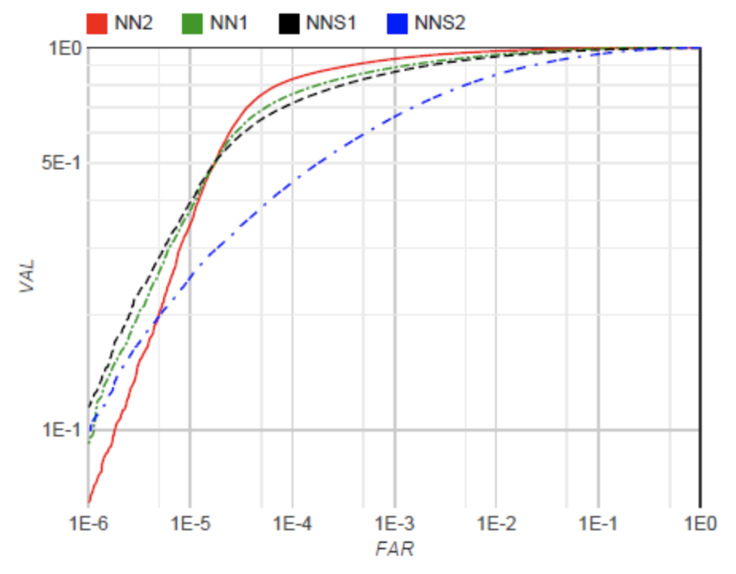
Experiments - Effect of CNN Model

Slide 17
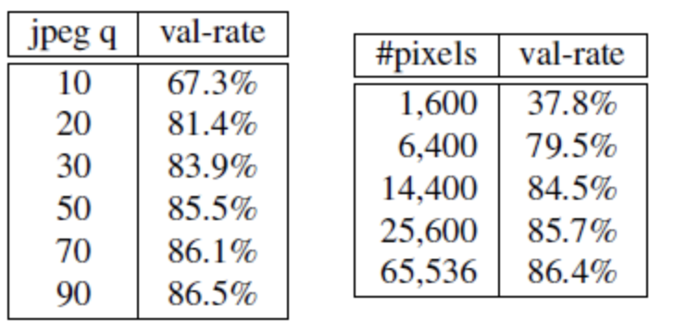
Experiments - Sensitivity to Image Quality

Slide 18
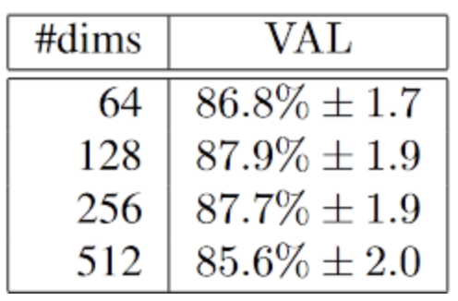
Experiments - Embedding Dimensionality

Slide 19
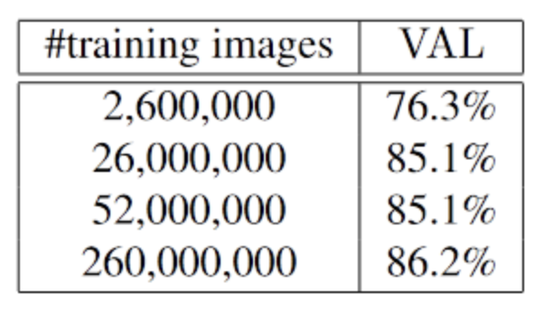
Experiments - Amount of Training Data

Slide 20
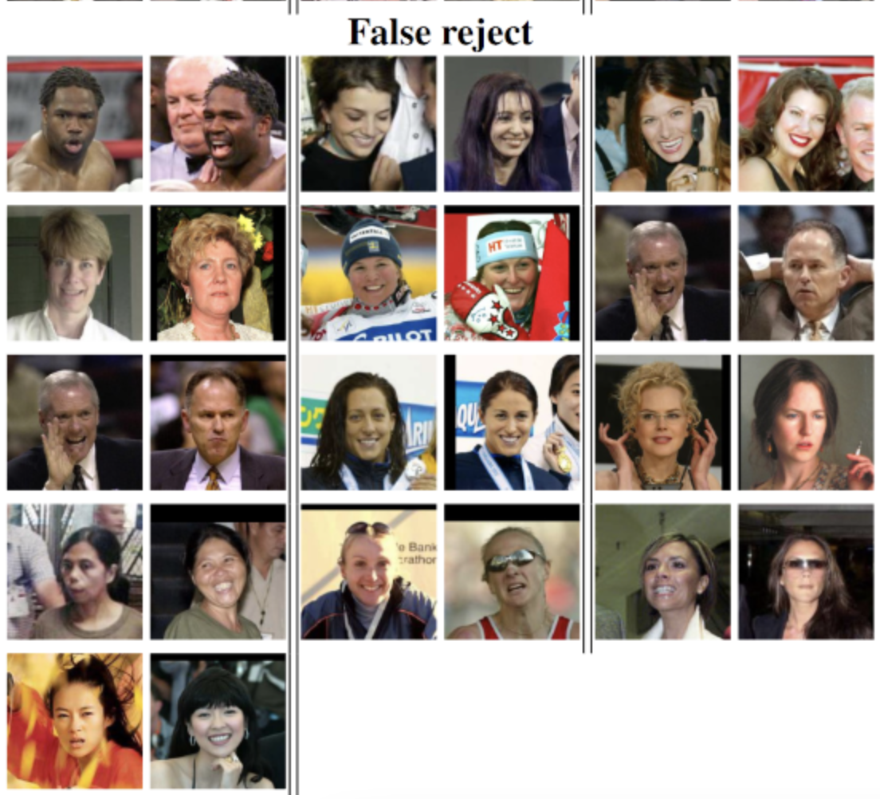
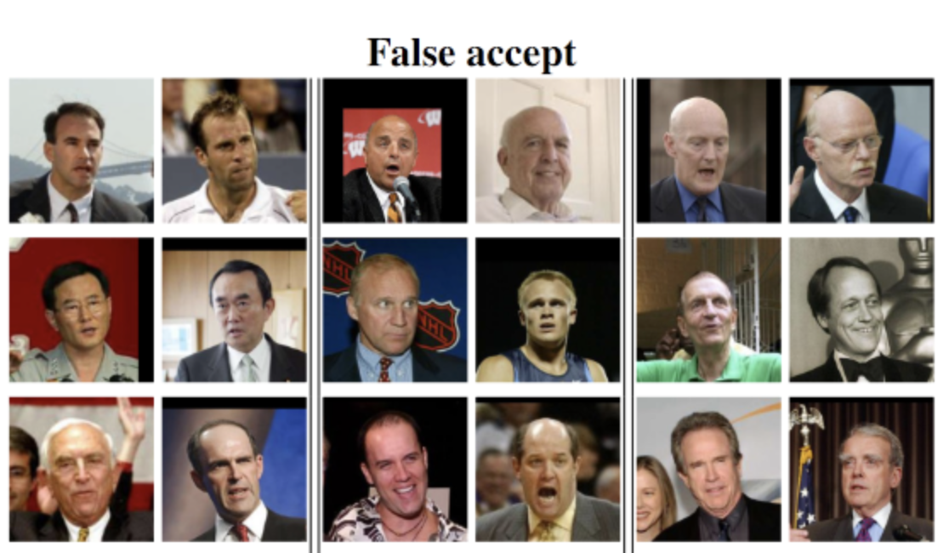
Experiments - Performance on LFW

Slide 21
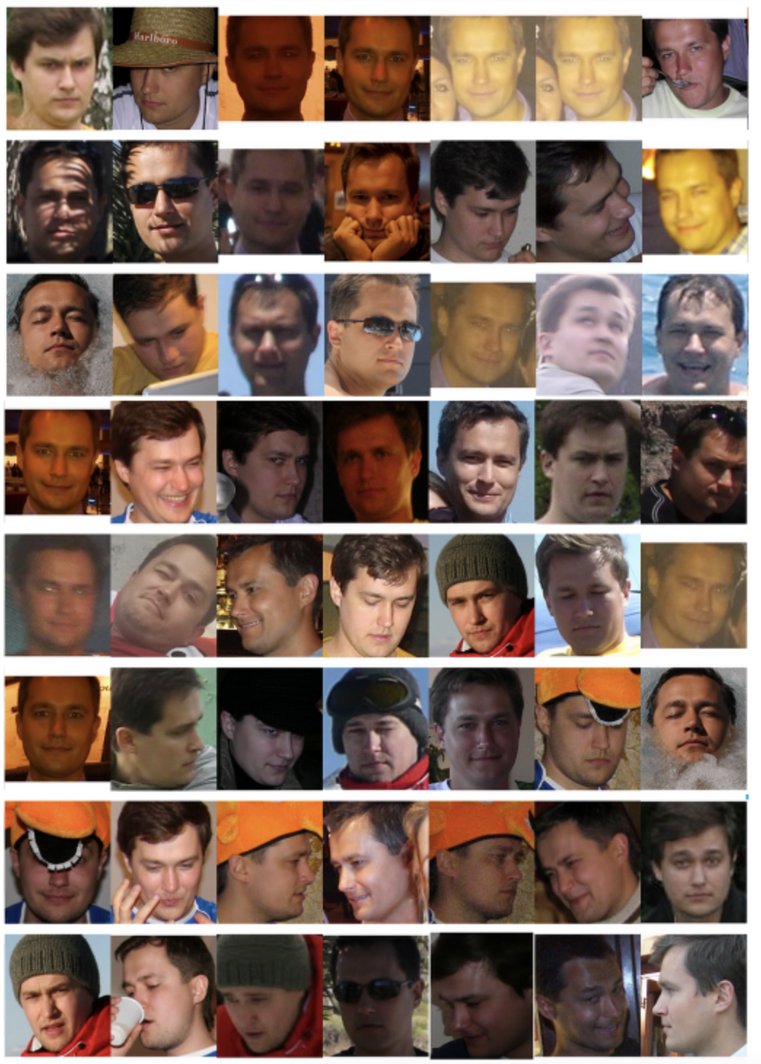
Experiments - Face Clustering

